Slide 1
FCI Learning Management System
Dr\ Essam Shaban

Slide 2
Introduction
This System Is Made So That The Relationship Between Lecturers & Students Be In An Easier Way.
The System Provides Privacy, In Other Words Only Lecturers & Students Who Belong To The Faculty Can Sign Up & Login To The System.

Slide 3
FCI LMS - Features
First Of All, The Lecturer or Student Should Make A Registration So That He Will Be Able To Use The Features Of The System.
The Registration Will Be Made Using The Basic Info Given To Them By The Admin.
For The Lecturer Side: First Name, Last Name, Department & Username.
For The Student Side: ID Number, First Name, Last Name & Class
Then They Have To Make A Login.

Slide 4
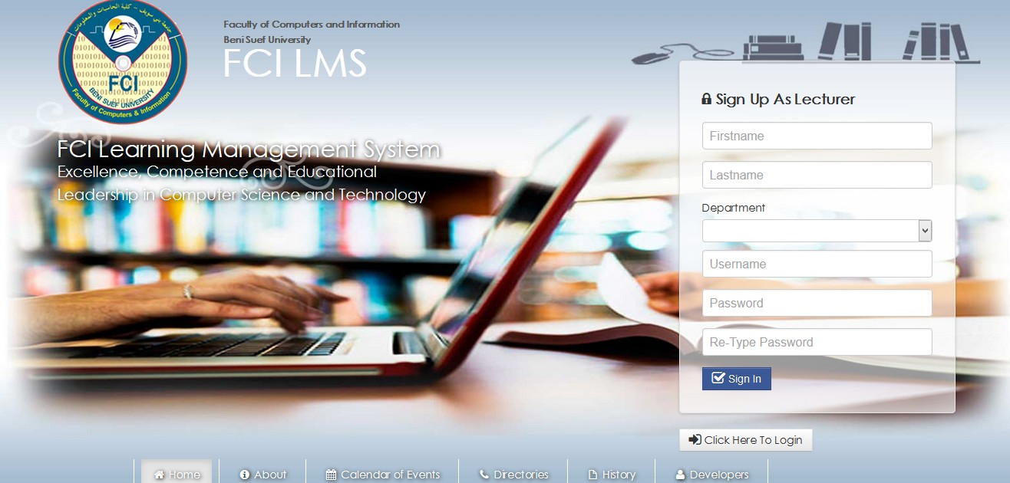
The Registration Form Of The Lecturers

Slide 5
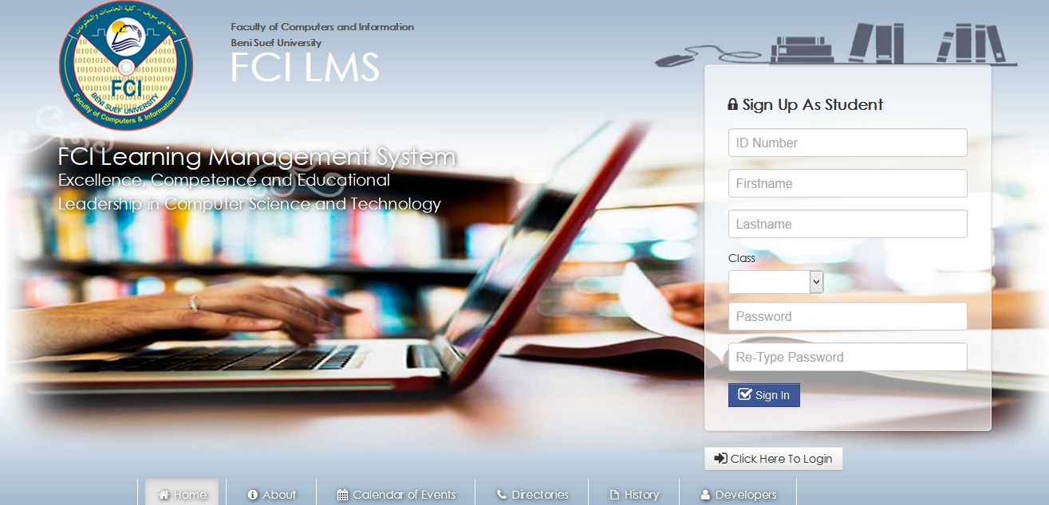
The Registration Form Of The Students

Slide 6
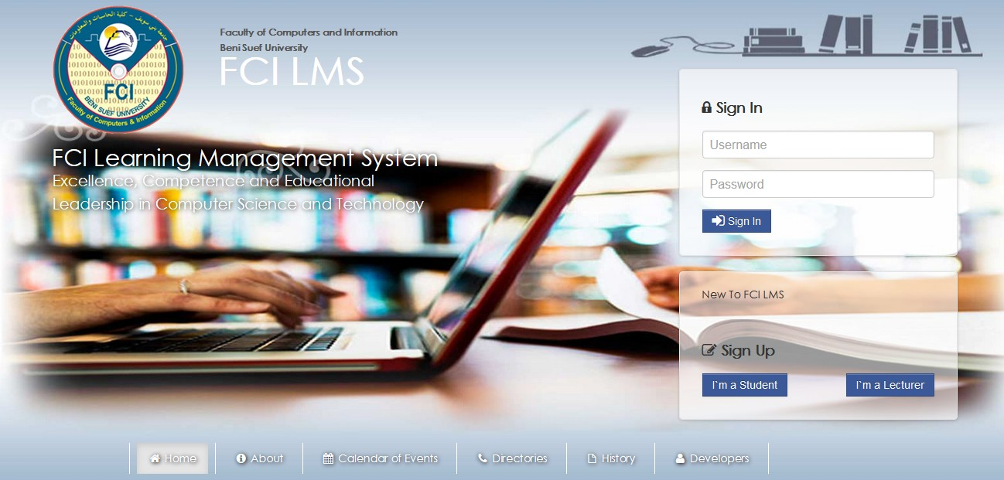
The Login Form For Both The Lecturers & Students

Slide 7
The Lecturer – Features 1. Creating An Educational Group For A Specific Subject
He Will Be Asked To Choose The Class, Subject & Educational Year For Which The Group Will Be Made
Then He Will Be Asked To Save This Info So That the Group Will Be Created

Slide 8
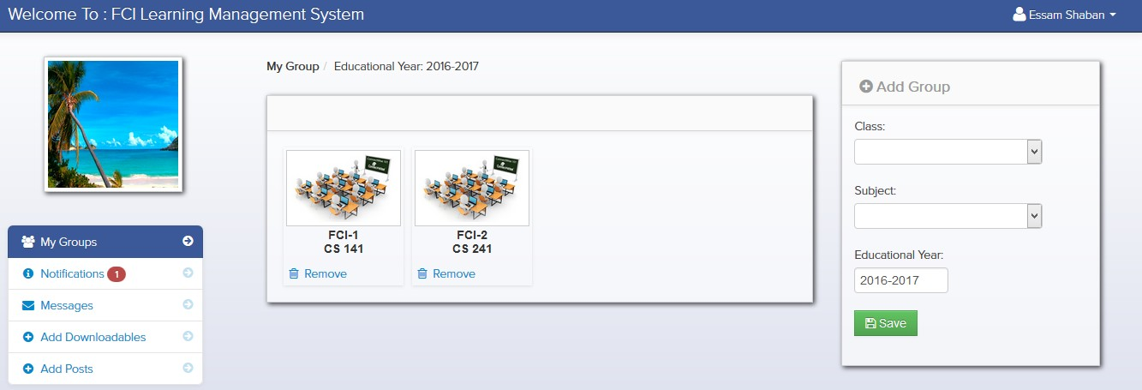
The Lecturer – Features 1. Creating An Educational Group For A Specific Subject

Slide 9
The Lecturer – Features 2. Downloading Downloadable Materials
He Will Be Asked To Access The Group From Which He Wants To Download The Uploaded Material File
Then He Will Find The Files Uploaded By Him or Other Students
Then He Will Be Able To Download These Files

Slide 10
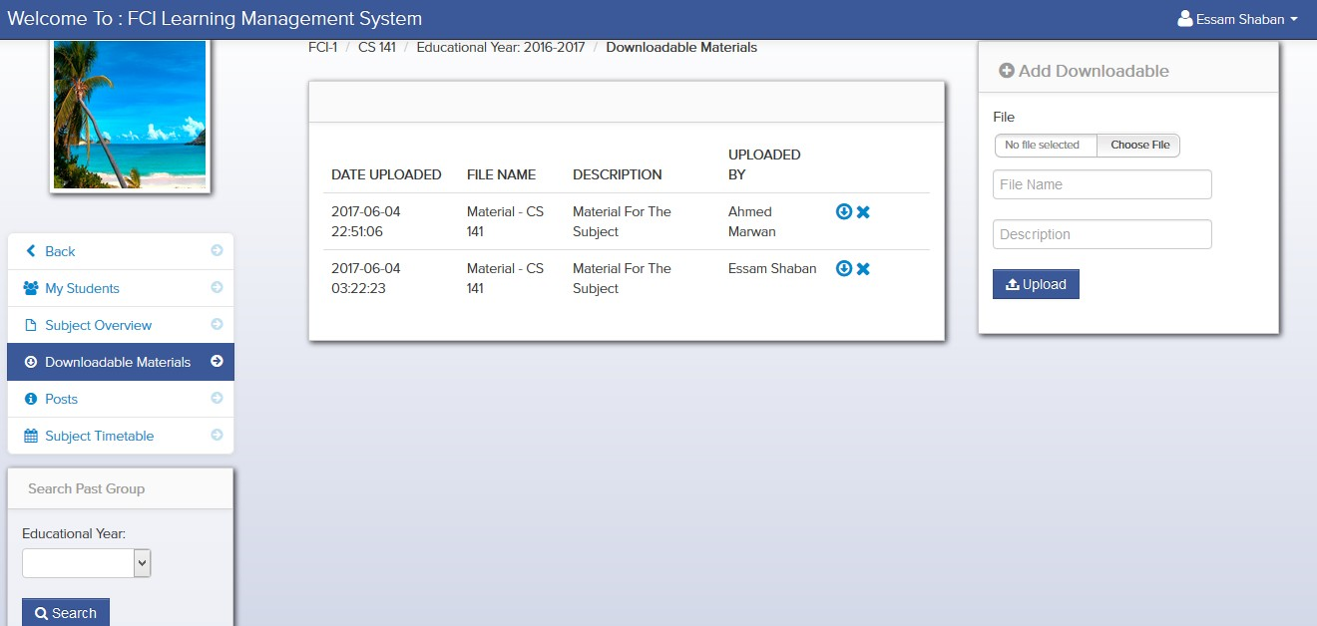
The Lecturer – Features 2. Downloading Downloadable Materials

Slide 11
The Lecturer – Features 3. Uploading Downloadable Materials
He Will Be Asked To Choose The File To Be Uploaded
He Will Be Asked To Choose For Which Group The File Will Be Uploaded
Then He Will Be Asked To Save This Info So That The File Will Be Uploaded

Slide 12
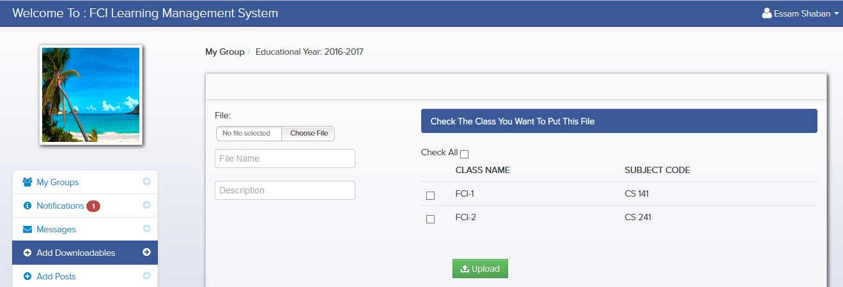
The Lecturer – Features 3. Uploading Downloadable Materials

Slide 13
The Lecturer – Features 4. Making Posts & Announcements
He Will Be Asked To Write The Content Of The Post He Want To Make
He Will Be Asked To Choose For Which Group The Post Will Be Gone
Then He Will Be Asked To Save This Info So That The Post Will Be Made

Slide 14
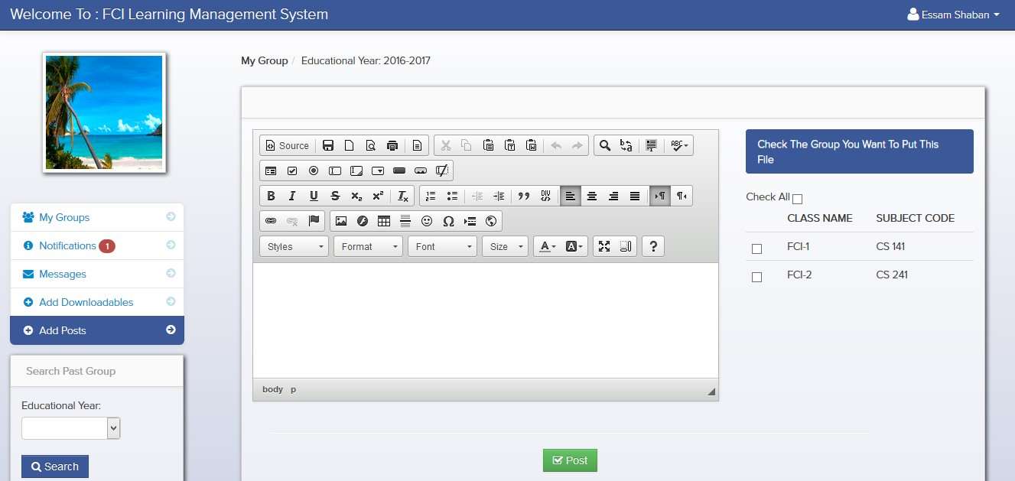
The Lecturer – Features 4. Making Posts & Announcements

Slide 15
The Lecturer – Features 5. Editing & Removing Posts & Announcements
He Has To Access The Group For Which The Posts Were Made
For Editing A Post, He Will Be Asked To Choose A Post Alter and Then Re-Post It
For Removing A Post, He Will Be Asked To Choose A Post and Then Remove It

Slide 16
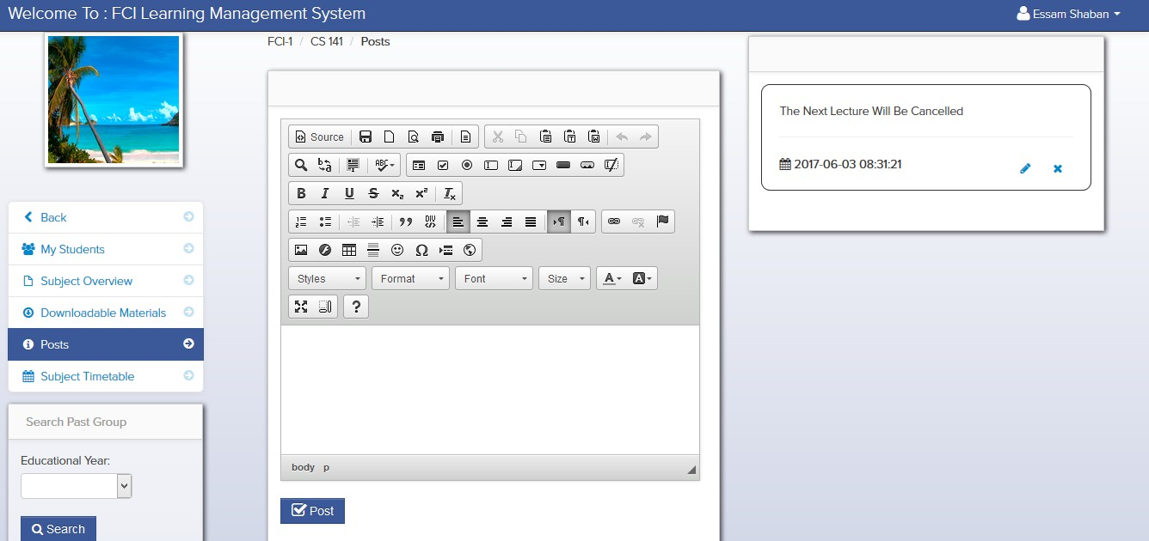
The Lecturer – Features 5. Editing & Removing Posts & Announcements

Slide 17
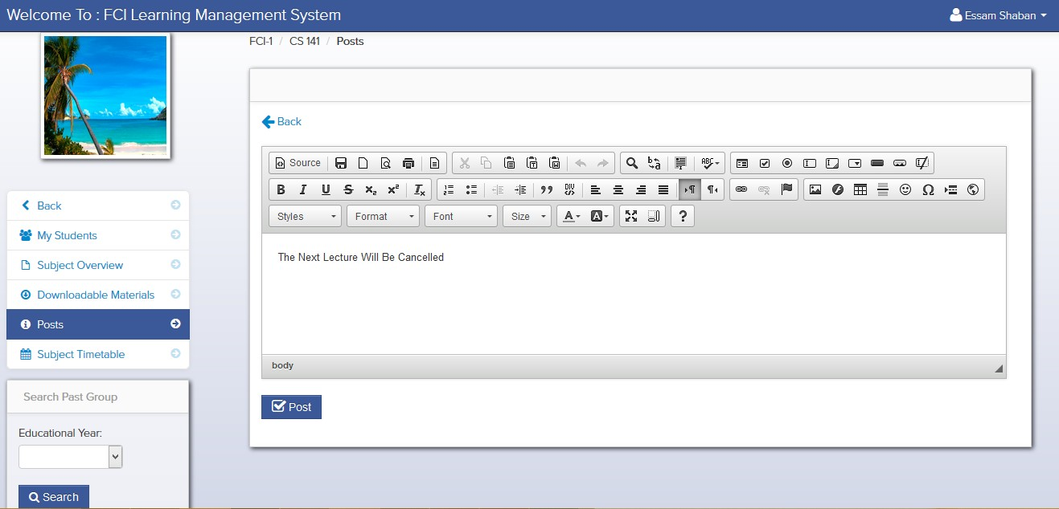
The Lecturer – Features 5. Editing Posts & Announcements

Slide 18
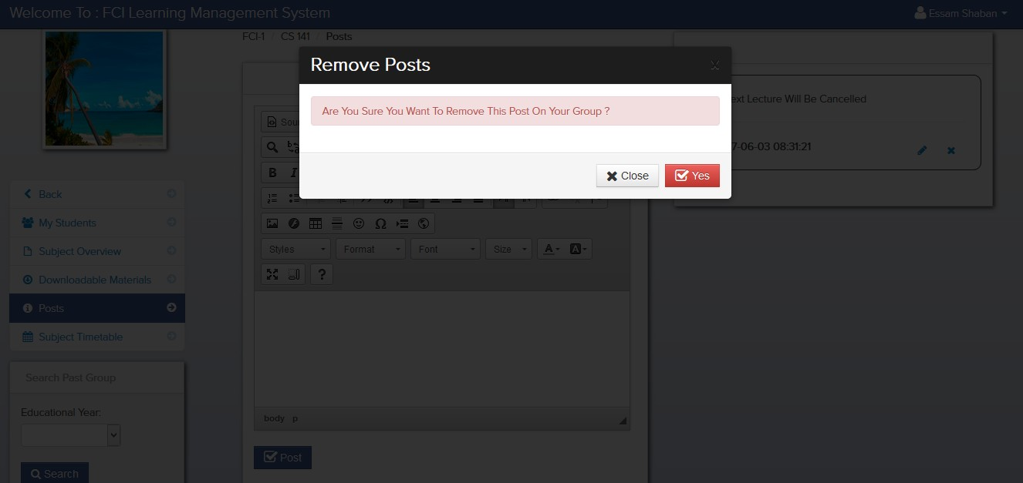
The Lecturer – Features 5. Removing Posts & Announcements

Slide 19
The Lecturer – Features 6. Viewing The Students In A Particular Group
He Has To Choose The Group In Which He Wants To View The Students

Slide 20
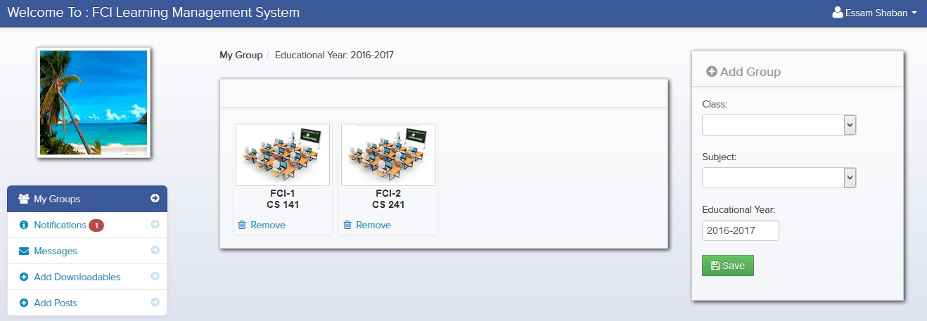
The Lecturer – Features 6. Viewing The Students In A Particular Group

Slide 21
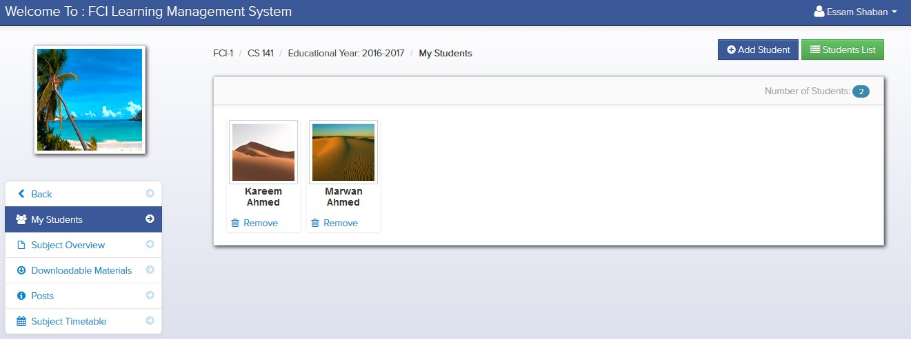
The Lecturer – Features 6. Viewing The Students In A Particular Group

Slide 22
The Lecturer – Features 7. Sending & Receiving Messages From & To Lecturers or Students
He Has To Choose Whether He Want To Send Messages To A Lecturer or A Student
He Has To Choose A Lecturer or A Student
Then He Has To Write The Content Of The Message He Wants To Send
Then He Will Be Asked To Save This Info So That The Message Will Be Sent

Slide 23
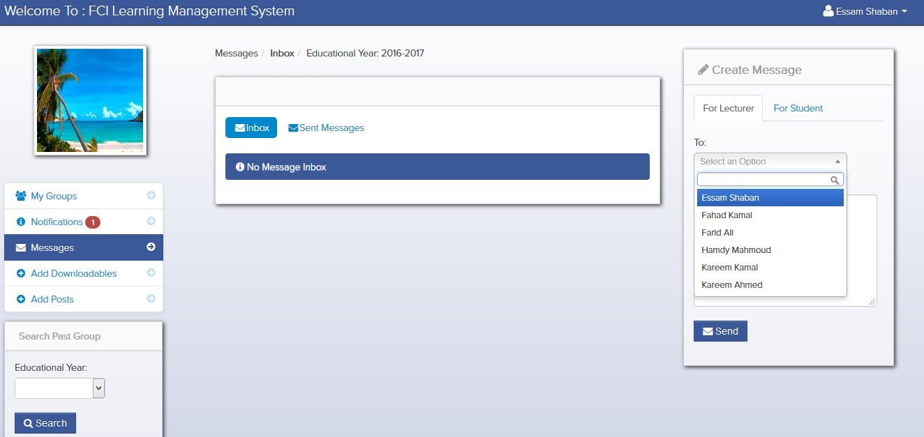
The Lecturer – Features 7. Sending Messages To Lecturers

Slide 24
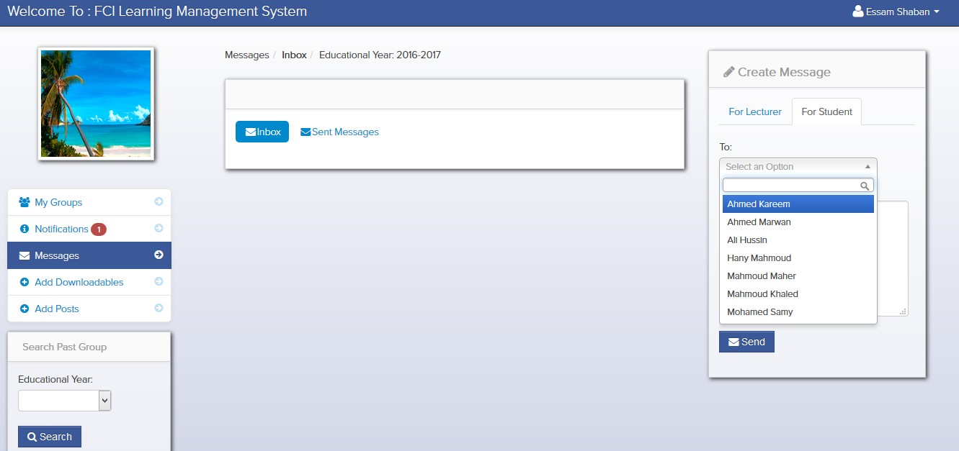
The Lecturer – Features 7. Sending Messages To Students

Slide 25
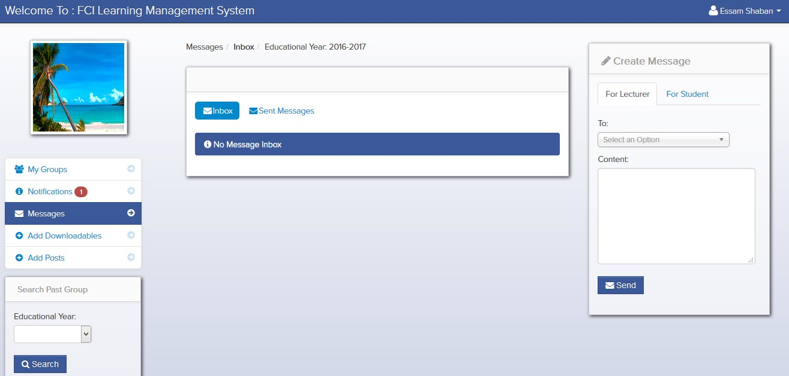
The Lecturer – Features 7. Receiving Messages From Lecturers or Students

Slide 26
The Lecturer – Features 8. Receiving Notifications From Students & Lecturers
The Notifications He Receives Will Be About Any Downloadable Materials Are Uploaded By Students To A Group He Created
The Notification Will Include The Name Of Student He Uploads The Downloadable Material File and The Name Of The Group He Uploads This File To As A Link

Slide 27
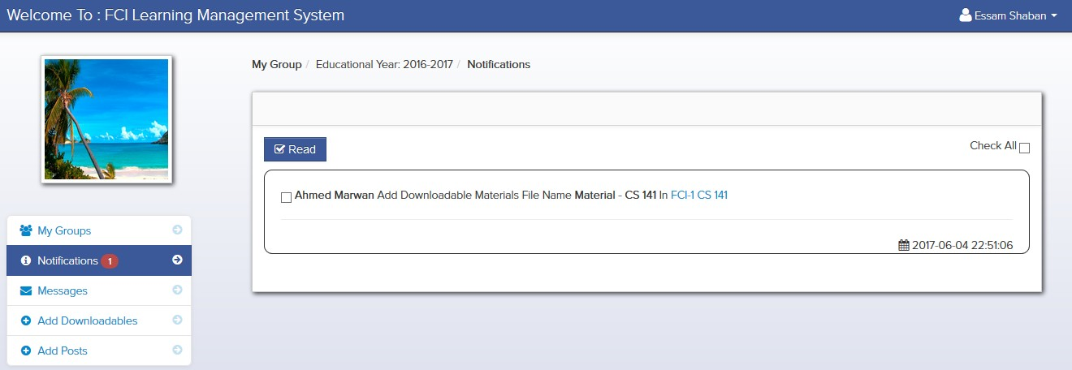
The Lecturer – Features 8. Receiving Notifications From Students & Lecturers

Slide 28
The Lecturer – Features 9. Making & Editing A Subject Overview
He Will Be Asked To Write An Overview Of The Subject So That He Will Be Able To Make A Subject Overview
He Will Be Asked To Alter His Previous Overview So That He Will Be Able To Edit It
Then He Will Be Asked To Save This Info Whether For Making Or Editing A Subject Overview

Slide 29
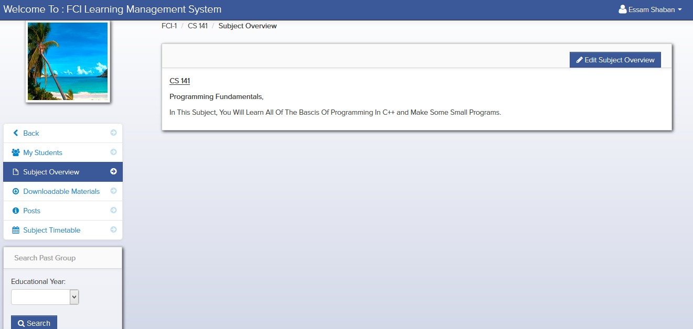
The Lecturer – Features 9. Making A Subject Overview

Slide 30
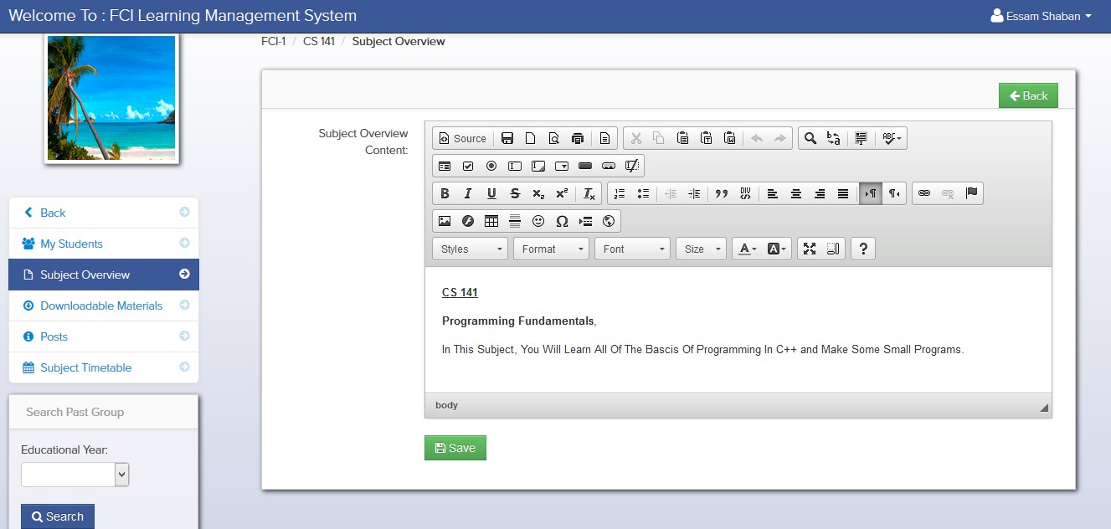
The Lecturer – Features 9. Editing A Subject Overview

Slide 31
The Lecturer – Features 10. Making A Subject Timetable
He Has To Access The Group For Which He Wants To Add This Timetable
He Will Be Asked To Choose The Starting Date Of The Subject (The First Lecture)
He Will Be Asked To Choose The Ending Date Of The Subject (The Last Lecture)
He Will Be Asked To Write A Title For Each Event Within The Timetable

Slide 32
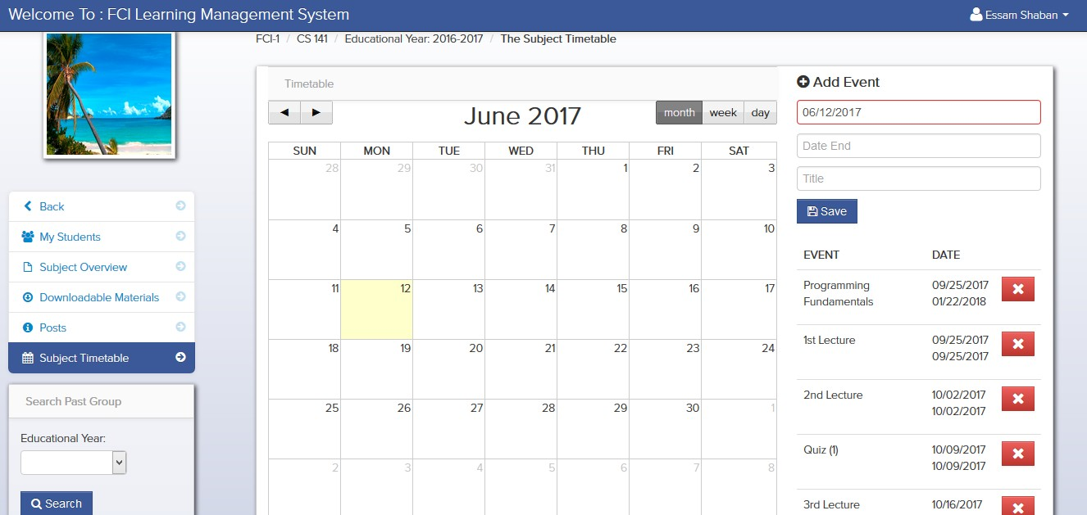
The Lecturer – Features 10. Making A Subject Timetable

Slide 33
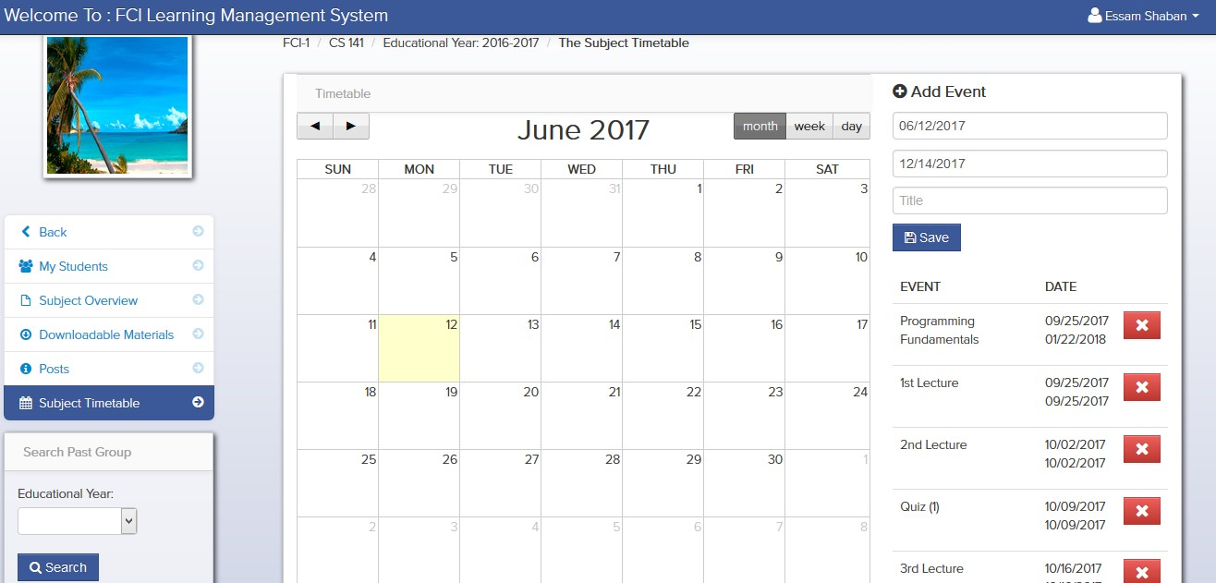
The Lecturer – Features 10. Making A Subject Timetable

Slide 34
The Lecturer – Features 11. Adding Students To Groups
He Has To Choose Which Students He Wants To Add
Then He Has To Add Them To The Group He Made

Slide 35
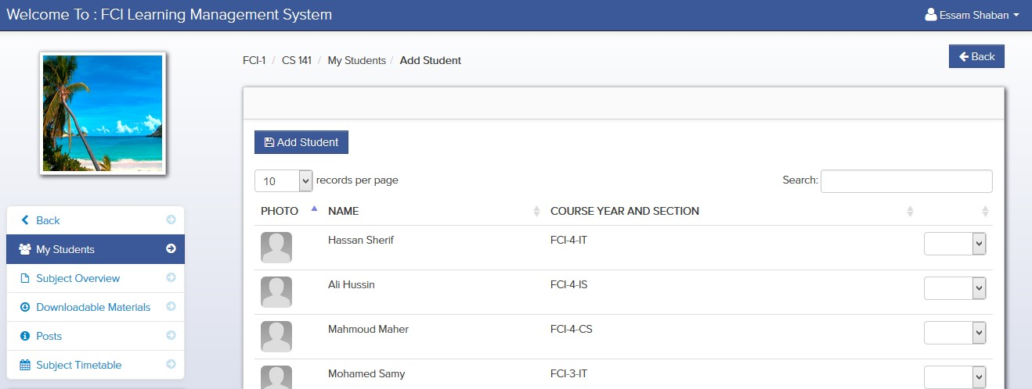
The Lecturer – Features 11. Adding Students To Groups

Slide 36
The Lecturer – Features 12. Printing Students In Groups
He Has To Access The Students List In A Specific Group He Made
Then He Has To Print Them

Slide 37
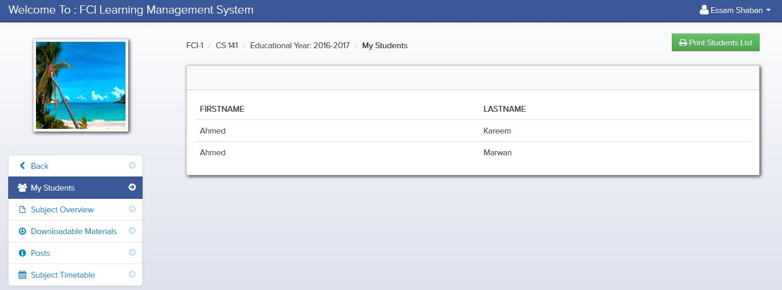
The Lecturer – Features 12. Printing Students In Groups

Slide 38
The Lecturer – Features 13. Editing Profile
He Will Be Asked To Choose A Picture For His Profile
For Changing His Password He Will Be Asked To Write His Current Password and Then His New Password and The Re-Write It

Slide 39
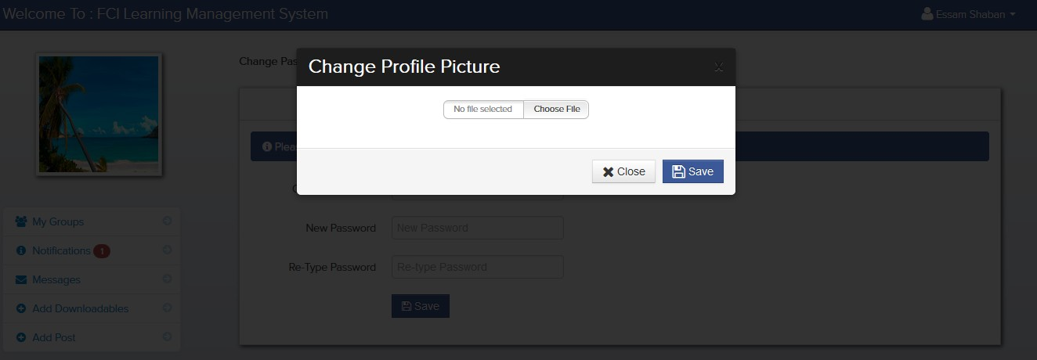
The Lecturer – Features 13. Changing The Profile Picture

Slide 40
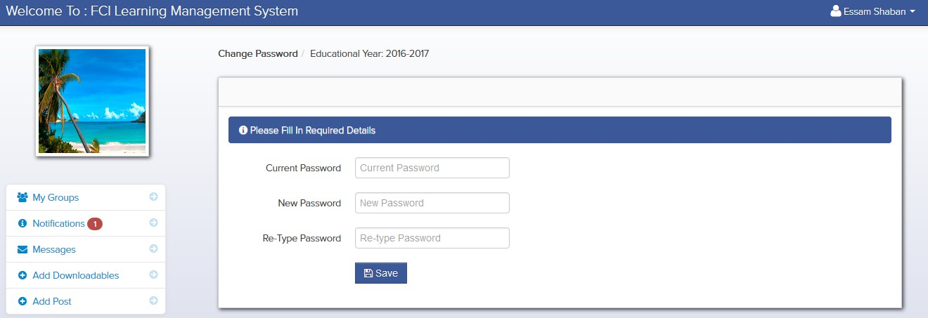
The Lecturer – Features 13. Changing The Password

Slide 41
The Student – Features 14. Viewing The Colleges In A Particular Group
He Has To Choose The Group In Which He Wants To View The Colleges

Slide 42
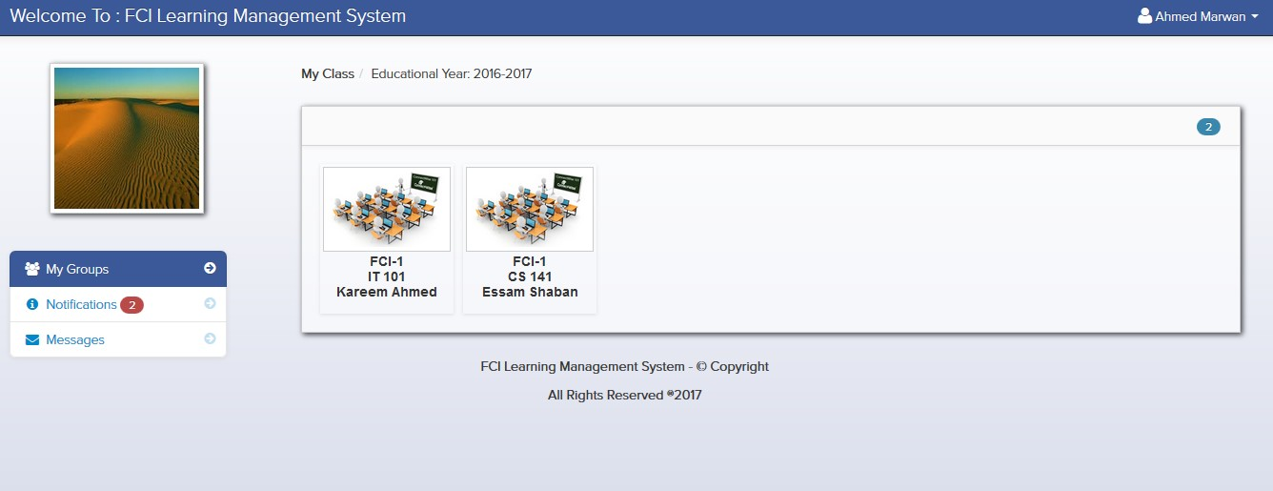
The Student – Features 14. Viewing The Colleges In A Particular Group

Slide 43
The Student – Features 15. Downloading Downloadable Materials
He Will Be Asked To Access The Group From Which He Wants To Download The Uploaded Material File
Then He Will Find The Files Uploaded By The Lecturer Who Created That Group or Uploaded By Other Students
Then He Will Be Able To Download These Files

Slide 44
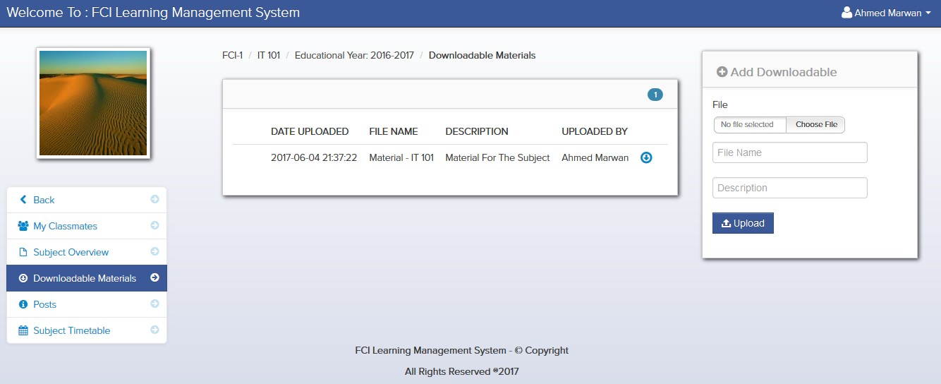
The Student – Features 15. Downloading Downloadable Materials

Slide 45
The Student – Features 16. Uploading Downloadable Materials
He Will Be Asked To Choose The File To Be Uploaded
He Will Be Asked To Choose For Which Group The File Will Be Uploaded
Then He Will Be Asked To Save This Info So That The File Will Be Uploaded

Slide 46
The Lecturer – Features 16. Uploading Downloadable Materials

Slide 47
The Student – Features 17. Sending & Receiving Messages From & To Lecturers or Students
He Has To Choose Whether He Want To Send Messages To A Lecturer or A Student
He Has To Choose A Lecturer or A Student
Then He Has To Write The Content Of The Message He Wants To Send
Then He Will Be Asked To Save This Info So That The Message Will Be Sent

Slide 48
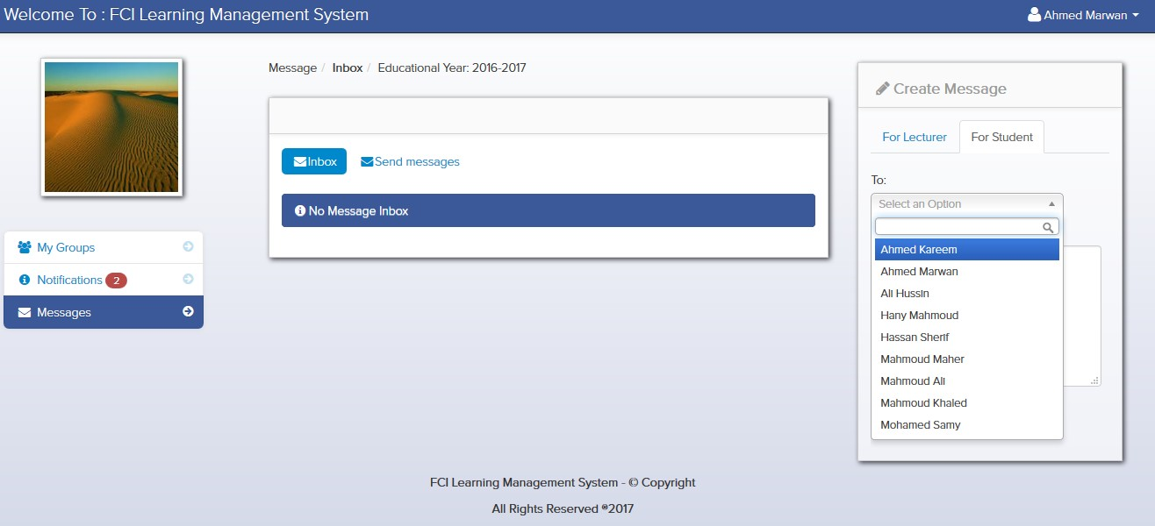
The Student – Features 17. Sending Messages To Students

Slide 49
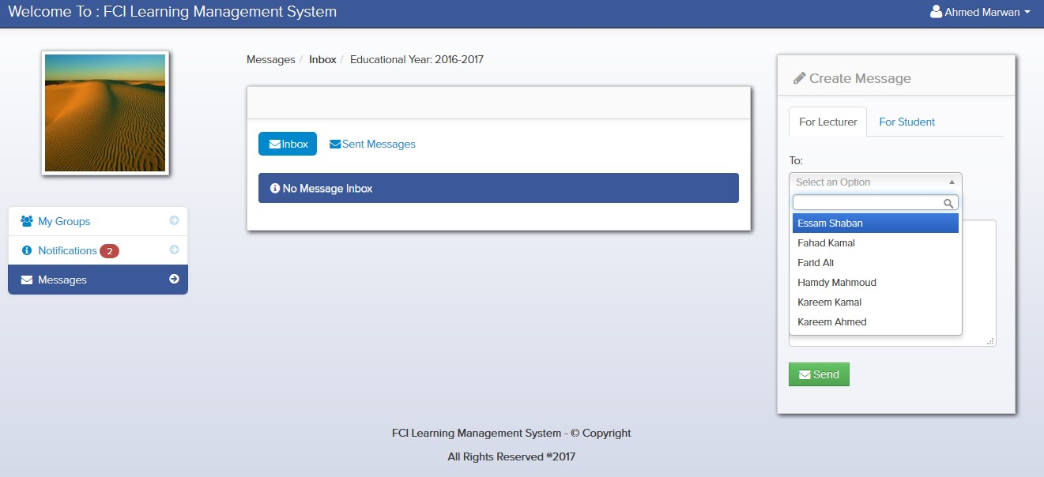
The Student – Features 17. Sending Messages To Lecturers

Slide 50
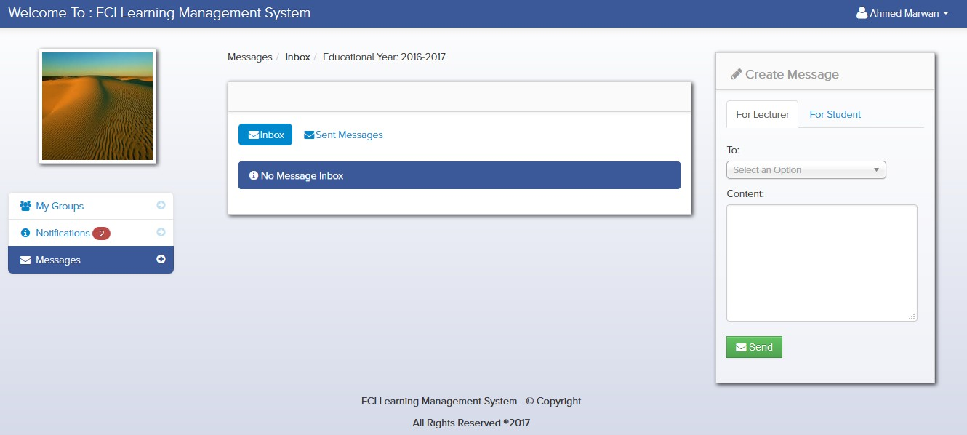
The Student – Features 17. Receiving Messages From Students & Lecturers

Slide 51
The Student – Features 18. Receiving Notifications From Students & Lecturers
The Notifications He Receives Will Be About Any Downloadable Materials Are Uploaded By Students To A Group He Created or Any Post Made By The Lecturer Who Created The Group
The Notification Will Include The Name Of Student He Uploads The Downloadable Material File and The Name Of The Group In Which The File Was Uploaded To As A Link

Slide 52
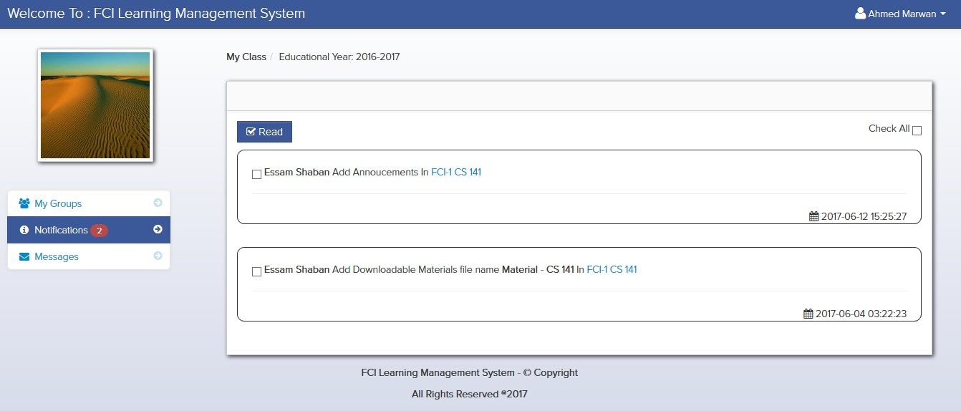
The Student – Features 18. Receiving Notifications From Students & Lecturers

Slide 53
The Student – Features 19. Receiving Subjects Overviews Made By Lecturers
The Subject Overview Is A Small Summery About The Subject Made By The Lecturer Who Teaches It.

Slide 54
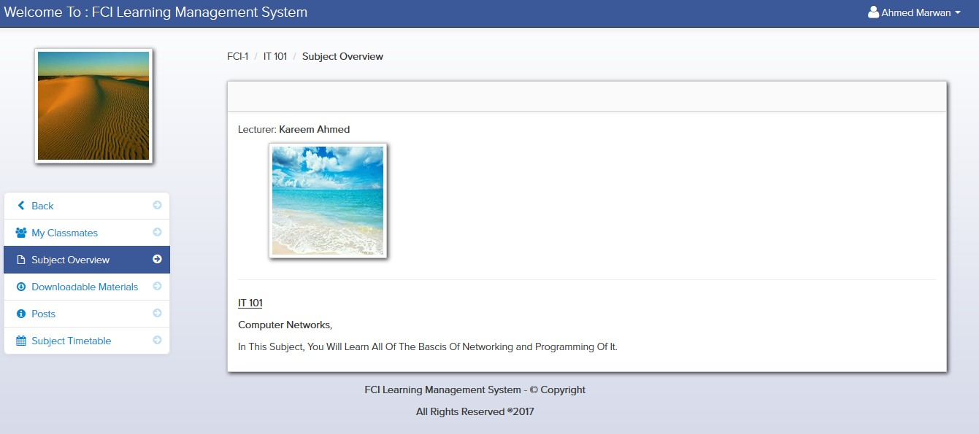
The Student – Features 19. Receiving Subjects Overviews Made By Lecturers

Slide 55
The Student – Features 20. Receiving Subjects Timetables Made By Lecturers
The Subject Timetable Is A Timing Map For The Subject Which Includes:
The Starting Date Of The Subject
The Ending Date Of The Subject
Dates Of Lectures
Dates Of Quizzes
Date Of Midterm Exam
Date Of Practical Exam
Date Of Final Exam

Slide 56
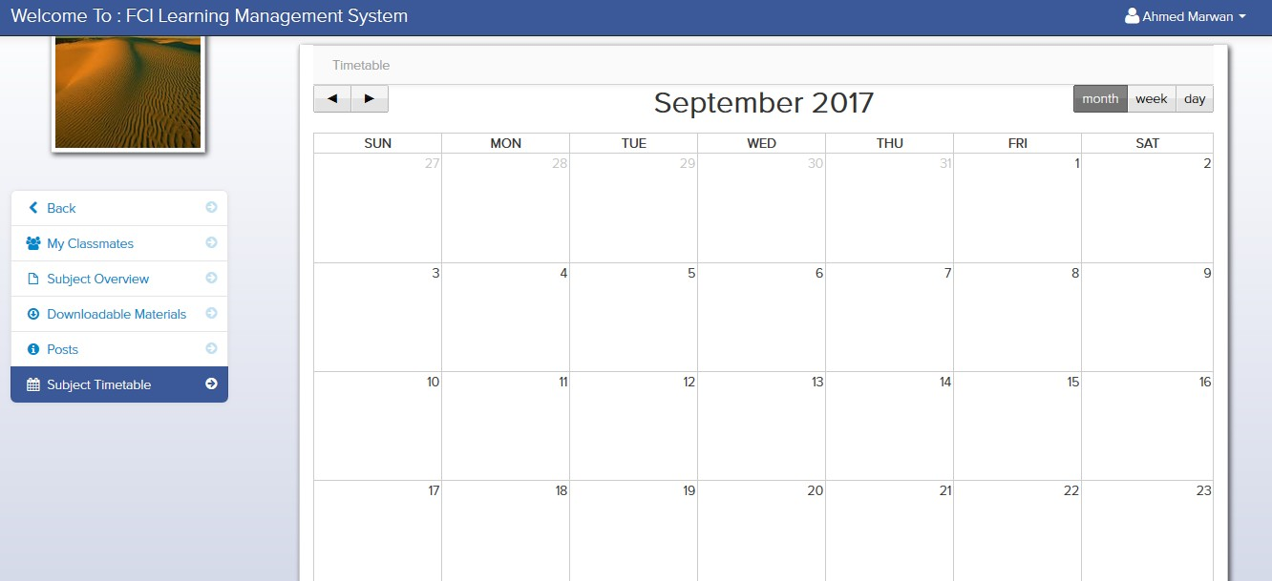
The Student – Features 20. Receiving Subjects Timetables Made By Lecturers

Slide 57
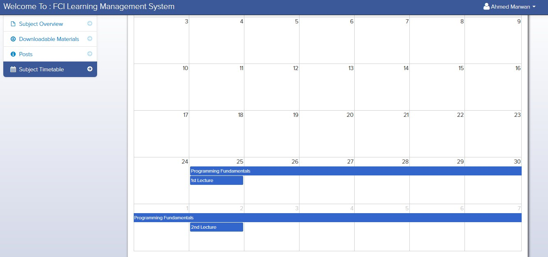
The Student – Features 20. Receiving Subjects Timetables Made By Lecturers

Slide 58
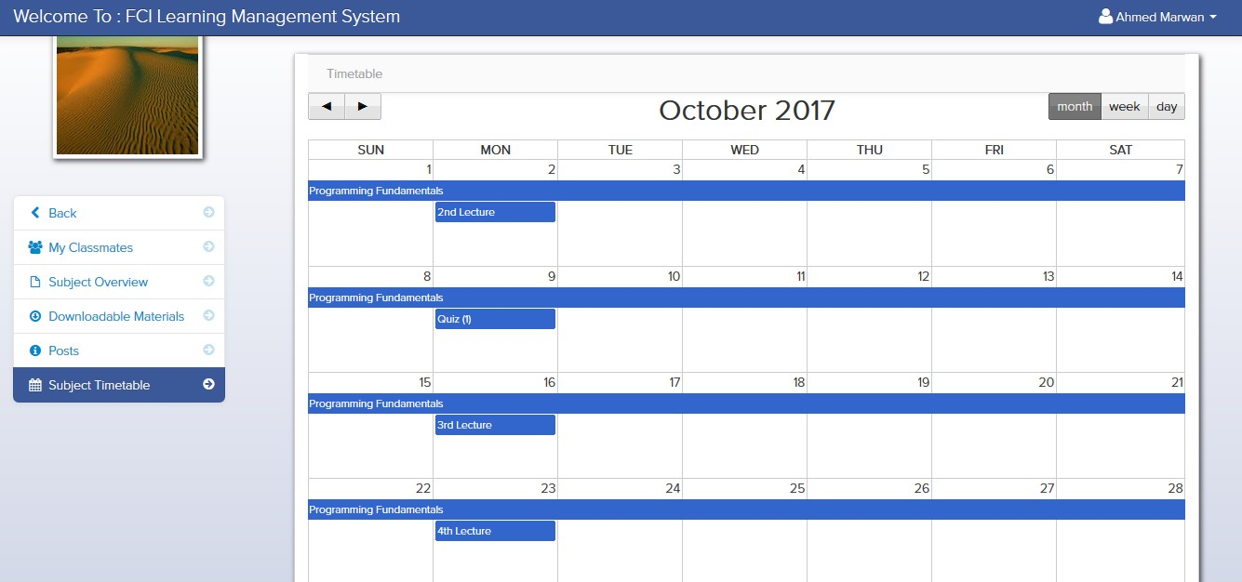
The Student – Features 20. Receiving Subjects Timetables Made By Lecturers

Slide 59
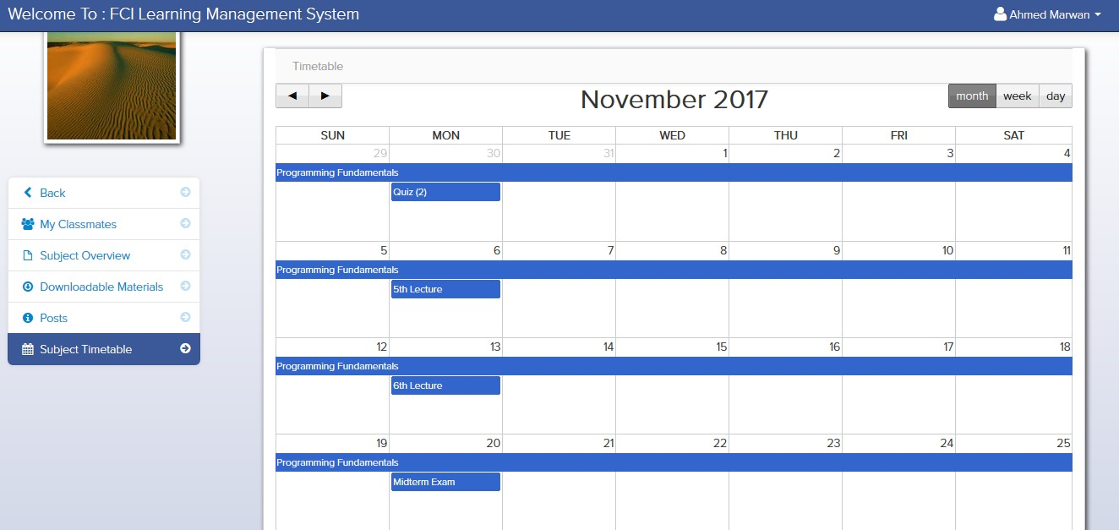
The Student – Features 20. Receiving Subjects Timetables Made By Lecturers

Slide 60
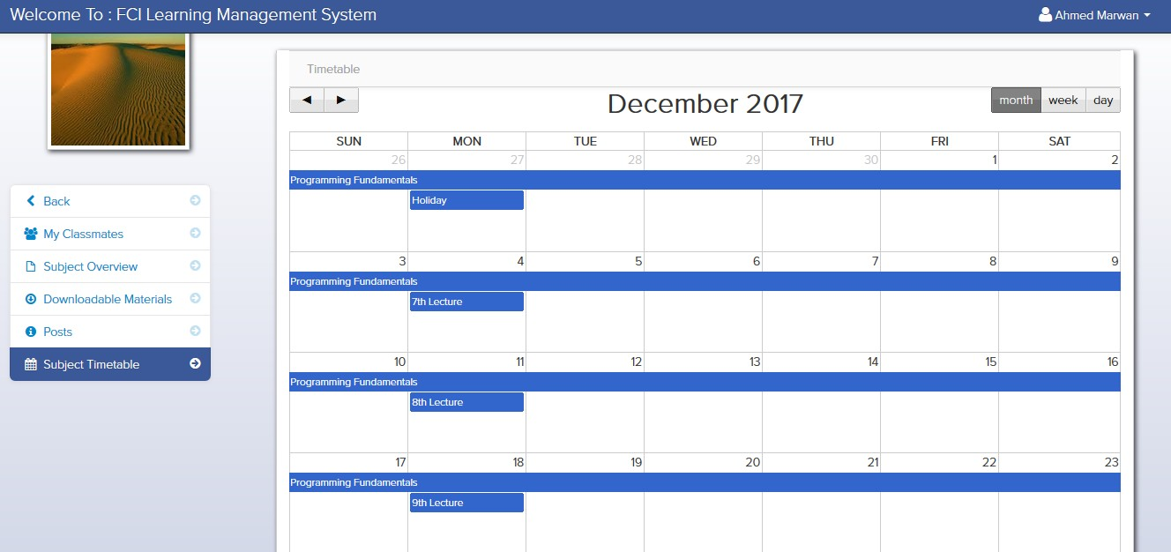
The Student – Features 20. Receiving Subjects Timetables Made By Lecturers

Slide 61
The Student – Features 21. Editing Profile
He Will Be Asked To Choose A Picture For His Profile
For Changing His Password He Will Be Asked To Write His Current Password and Then His New Password and The Re-Write It

Slide 62
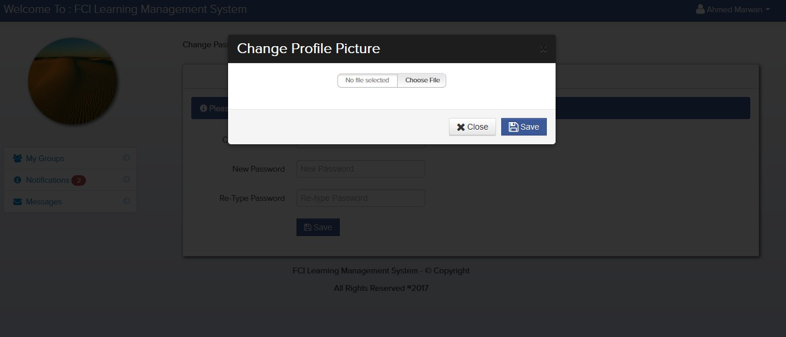
The Lecturer – Features 21. Changing The Profile Picture

Slide 63
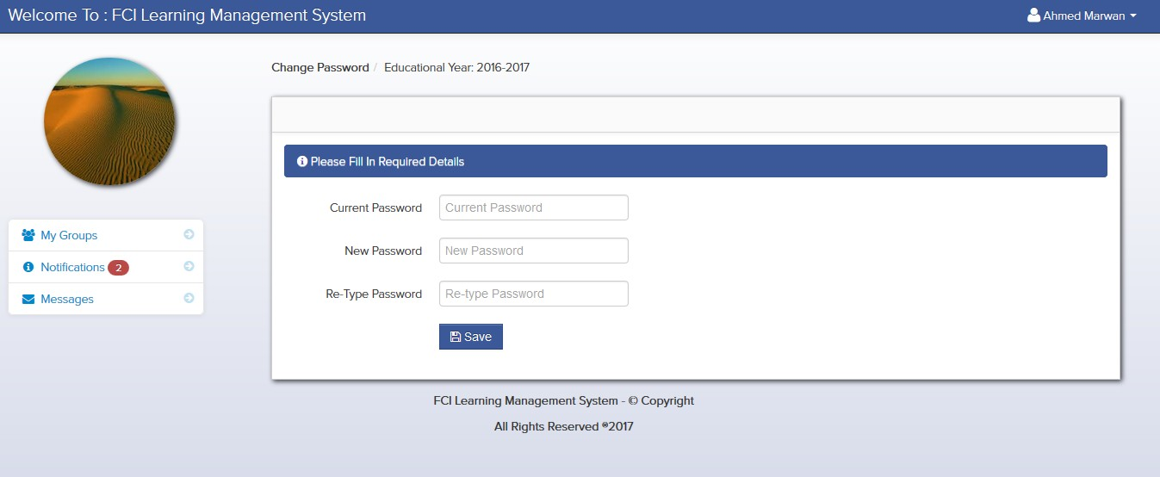
The Lecturer – Features 21. Changing The Password

Slide 64
The Admin – Features 22. Adding, Deleting & Editing The Students Info
For Adding A Student: He Has To Choose In Which Level The Student Is Then He Has To Add The Student’s Id Number, First Name & Last Name Then Saving These Info So That The Student Will Be Added
For Deleting A Student: He Has To Choose Which Student To Be Deleted
For Editing A Student: He Has To Choose Which Student He Wants To Edit Then He Has To Update His Old Info With His New Ones Like ID Number, Level, First Name & Last Name

Slide 65
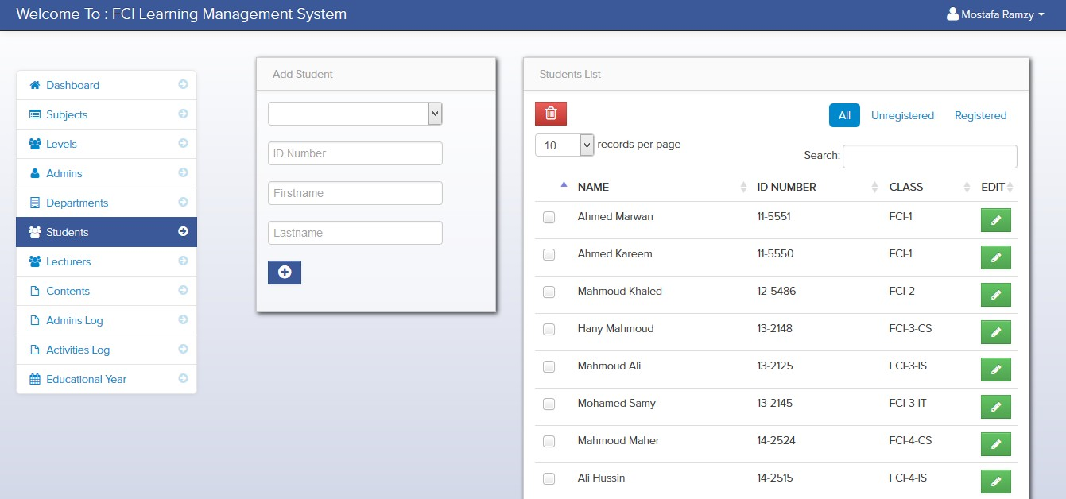
The Admin – Features 22. Adding & Deleting The Students Info

Slide 66
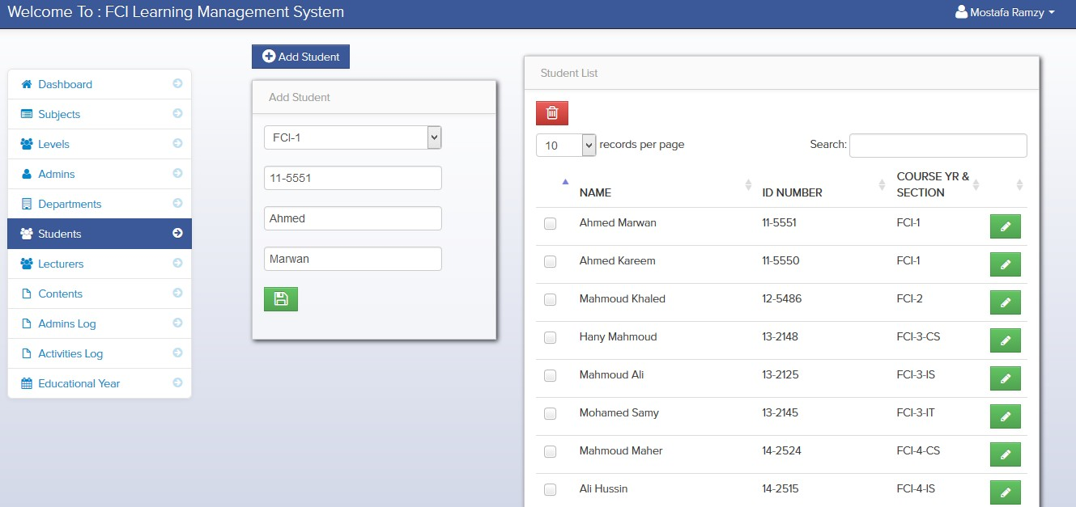
The Admin – Features 22. Editing The Students Info

Slide 67
The Admin – Features 23. Adding, Deleting & Editing The Departments Info
For Adding A Department: He Has To Add The Department’s Name & Person In-Charge Then Saving These Info So That The Department Will Be Added
For Deleting A Department : He Has To Choose Which Department To Be Deleted
For Editing A Department : He Has To Choose Which Department He Wants To Edit Then He Has To Update It’s Old Info With Its New Ones Like Department’s Name & Person In-Charge

Slide 68
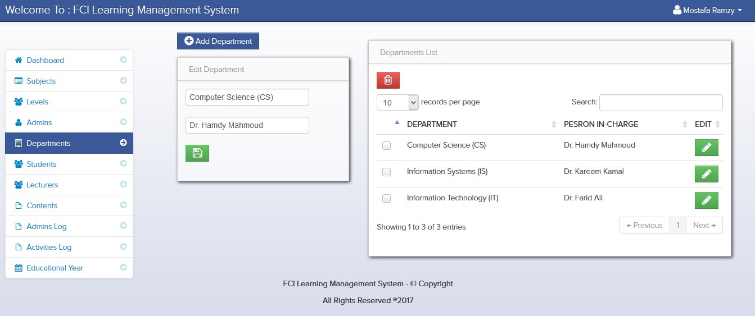
The Admin – Features 23. Adding & Deleting The Departments Info

Slide 69
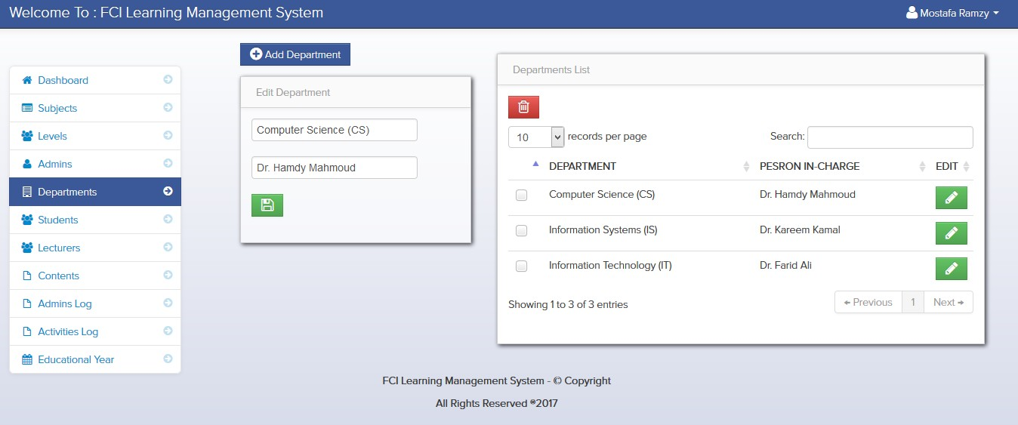
The Admin – Features 23. Editing The Students Info

Slide 70
The Admin – Features 24. Adding, Deleting & Editing The Lecturers Info
For Adding A Lecturer: He Has To Choose In Which Department He Is Then He Has To Add The Lecturer’s Firstname, Lastname & Username Then Saving These Info So That The Lecturer Will Be Added
For Deleting A Lecturer: He Has To Choose Which Lecturer To Be Deleted
For Editing A Lecturer: He Has To Choose Which Lecturer He Wants To Edit Then He Has To Update His Old Info With His New Ones Like Department, Firstname, Lastname & Username

Slide 71
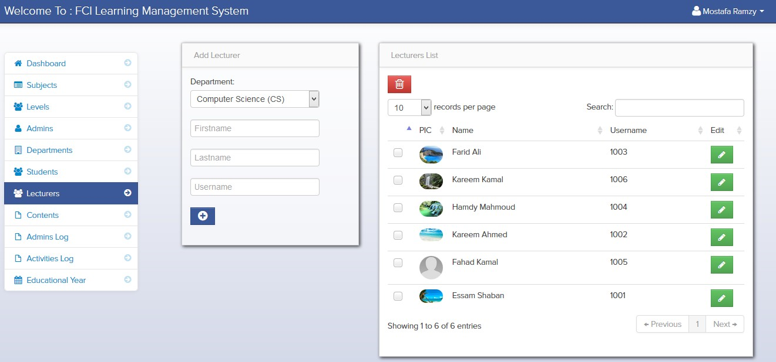
The Admin – Features 24. Adding & Deleting The Lecturers Info

Slide 72
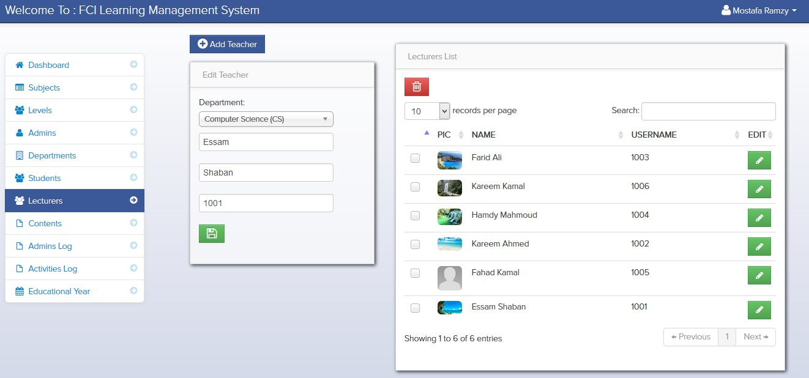
The Admin – Features 24. Editing The Lecturers Info

Slide 73
The Admin – Features 25. Adding, Deleting & Editing The Subjects Info
For Adding A Subject: He Has To Choose In Which Level & Semester It’s Taught Then He Has To Add The Subject’s Code, Title, Quiz Grade, Midterm Exam Grade, Practical Exam Grade, Final Exam Grade, Description and Also Its Number Of Units Then He Has To Determine If There Are Prerequisites For This Subject Or Not Finally He Has To Save These Info So That The Subject Will Be Added
For Deleting A Subject: He Has To Choose Which Subject To Be Deleted
For Editing A Subject: He Has To Choose Which Subject He Wants To Edit Then He Has To Update His Old Info With His New Ones Like Code, Title & Number Of Units

Slide 74
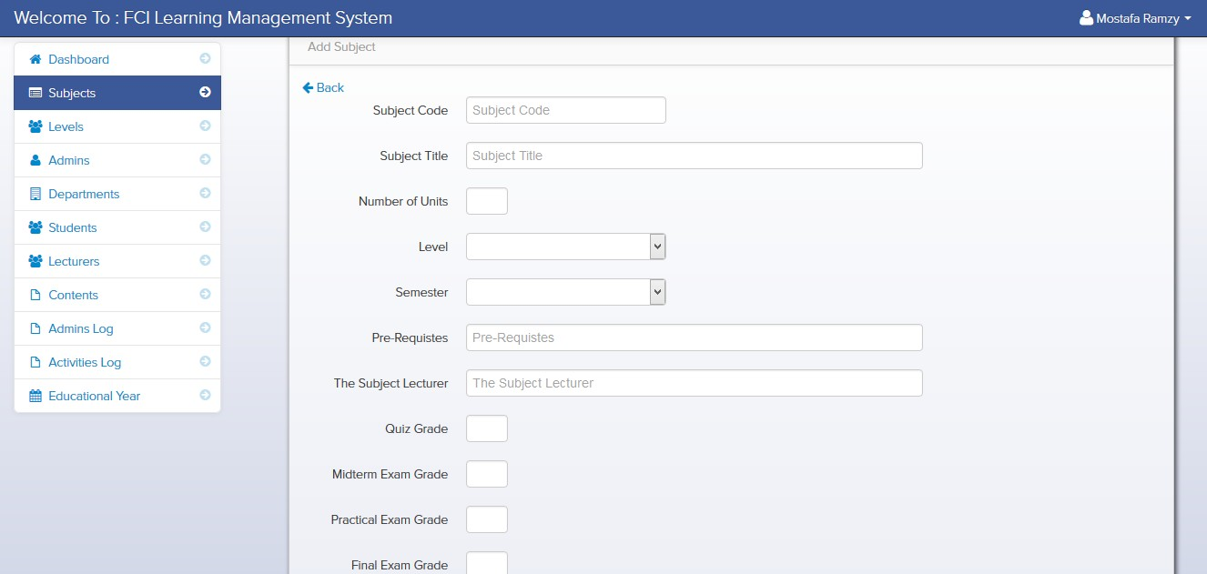
The Admin – Features 25. Adding The Subjects Info

Slide 75
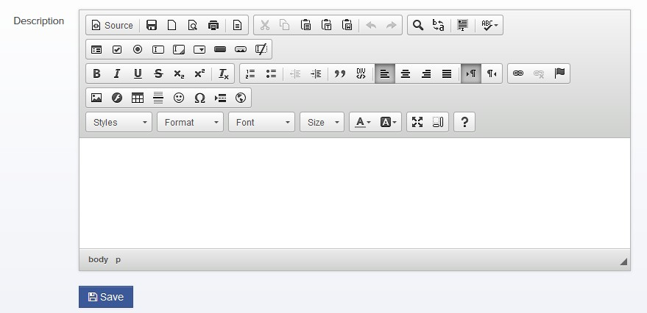
The Admin – Features 25. Adding The Subjects Info

Slide 76
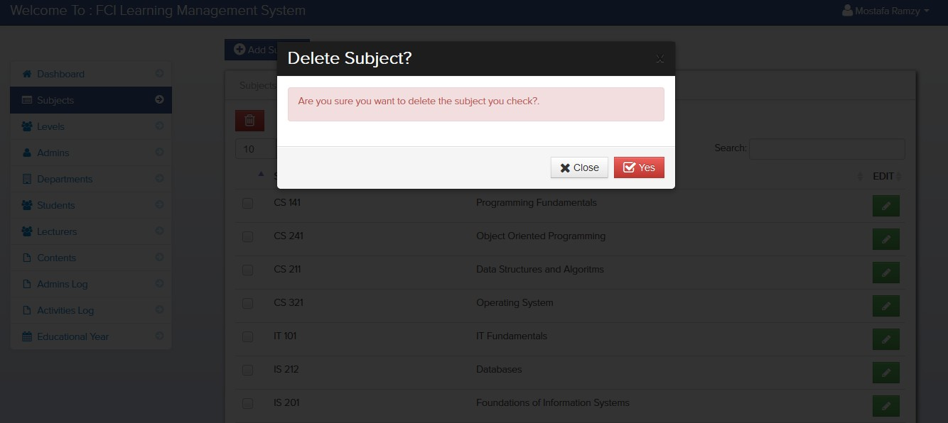
The Admin – Features 25. Deleting The Subjects Info

Slide 77
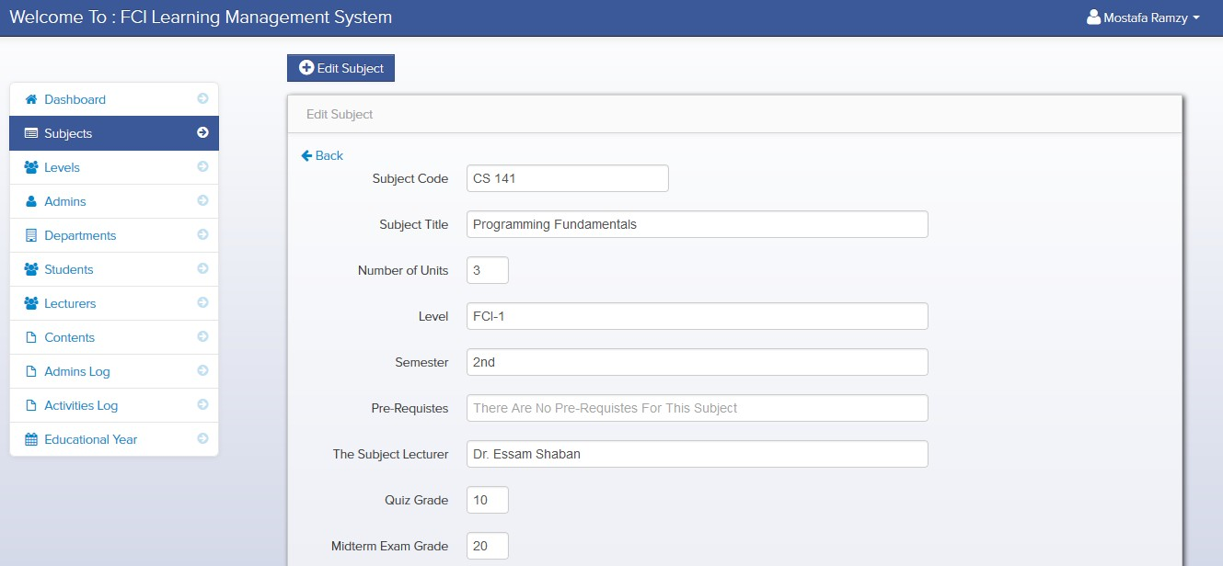
The Admin – Features 25. Editing The Subjects Info

Slide 78
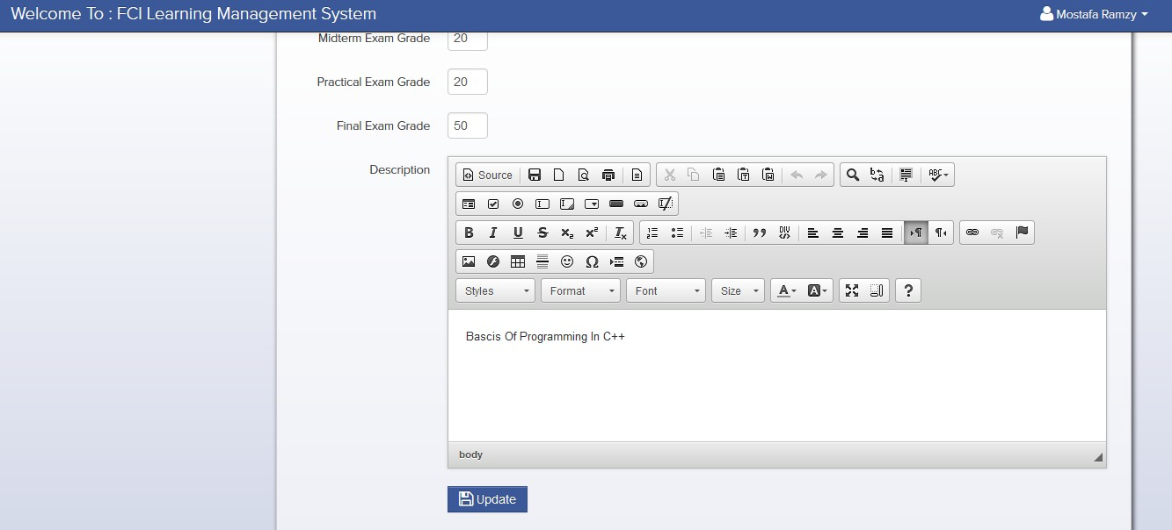
The Admin – Features 25. Editing The Subjects Info

Slide 79
The Admin – Features 26. Adding, Deleting & Editing The Static Pages Info
For Adding A Static Page: He Has To Add The Static Pages' Title & Content Then He Has To Save These Info So That The Static Page Will Be Added
For Deleting A Static Page: He Has To Choose Which Static Page To Be Deleted
For Editing A Static Page: He Has To Choose Which Static Page He Wants To Edit Then He Has To Update His Old Info With His New Ones Like Title

Slide 80
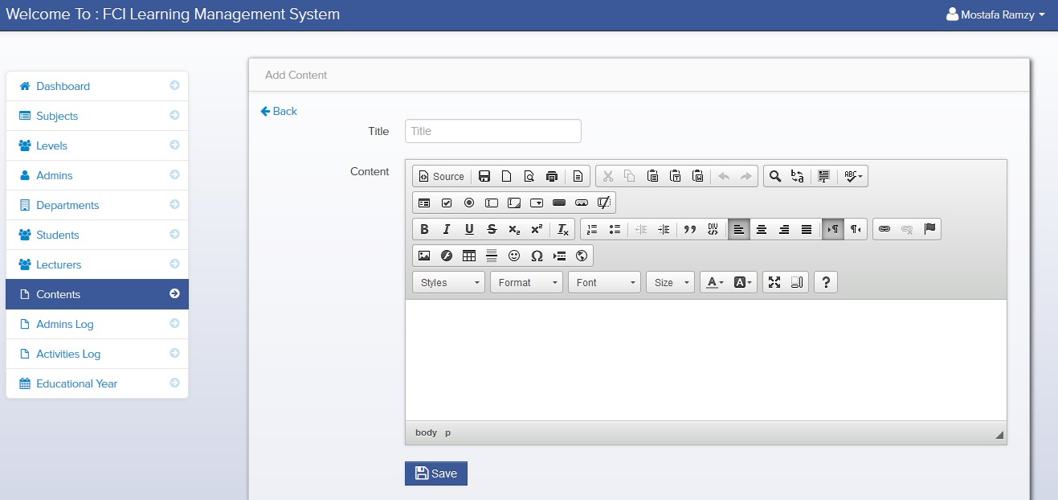
The Admin – Features 26. Adding The Static Page’s Info

Slide 81

The Admin – Features 26. Deleting The Static Page’s Info

Slide 82

The Admin – Features 26. Editing The Static Page’s Info

Slide 83
The Admin – Features 27. Viewing The Full Dashboard Of The System
He Has To Access The Dashboard So That He Can Know The Following Info:
The Total Number Of Students In The System
The Total Number Of Registered Students In The System
The Total Number Of Unregistered Students In The System
The Total Number Of Lecturers In The System
The Total Number Of Levels In The System
The Total Number Of Subjects In The System

Slide 84

The Admin – Features 27. Viewing The Full Dashboard Of The System

Slide 85
The Admin – Features 28. Adding, Deleting & Editing Profile
For Adding An Admin: He Has To Add The Admin’s First Name, Last Name, Username & Password
For Deleting An Admin: He Has To Choose Which Admin To Be Deleted
For Editing An Admin: He Has To Choose Which Admin He Wants To Edit Then He Has To Update His Old Info With His New Ones Like First Name, Last Name & Username

Slide 86

The Admin – Features 28. Adding The Admin Info

Slide 87

The Admin – Features 28. Deleting An Admin Info

Slide 88

The Admin – Features 28. Editing An Admin Info

Slide 89
The Admin – Features 29. Searching
He Can Search For A Topic Using It’s Username From The Following:
Subjects
Levels
Admins
Departments
Students
Lecturers
Static Pages
Admins Logs
Activities Logs

Slide 90

The Admin – Features 29. Searching For A Particular Subject

Slide 91

The Admin – Features 29. Searching For A Particular Level

Slide 92

The Admin – Features 29. Searching For A Particular Admin

Slide 93

The Admin – Features 29. Searching For A Particular Department

Slide 94

The Admin – Features 29. Searching For A Particular Student

Slide 95

The Admin – Features 29. Searching For A Particular Lecturer

Slide 96

The Admin – Features 29. Searching For A Particular Static Page

Slide 97

The Admin – Features 29. Searching For A Particular Admin Log

Slide 98

The Admin – Features 29. Searching For A Particular Activity Log

Slide 99
The Admin – Features 30. The System Has A Responsive Design
It Can Be Accessed and Run on Various Devices Like PCs, Laptops, Smart Phones and Tablets

Slide 100
Conclusion
The System Is Made To Handle The Relationship Between The Lecturers and Students As They Are The Main Parts In The Educational Process In Many Different Maters Such As:
Viewing Students In The Groups
Uploading & Downloading Material Files
Sending & Receiving Messages
Receiving Notifications From Each Other

